Slide 1


THE INTERACTIVE STORYTELLER
Based on the horror theme
GROUP 7
Data Fullstack Bootcamp

Slide 2
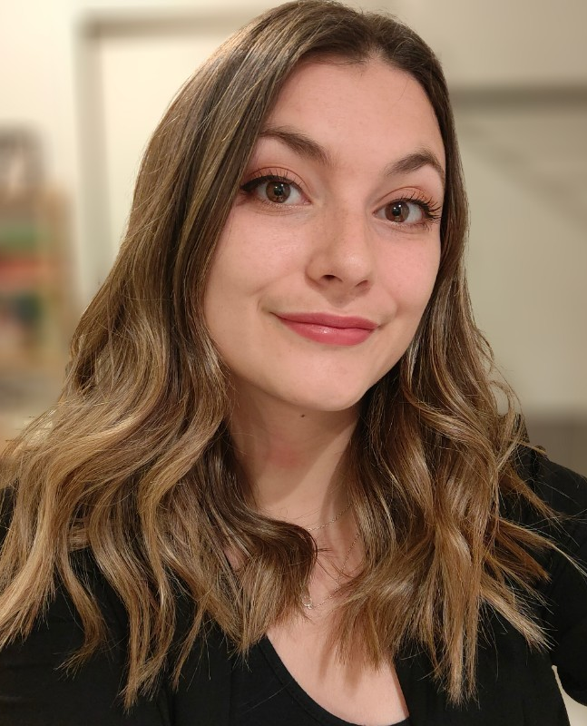
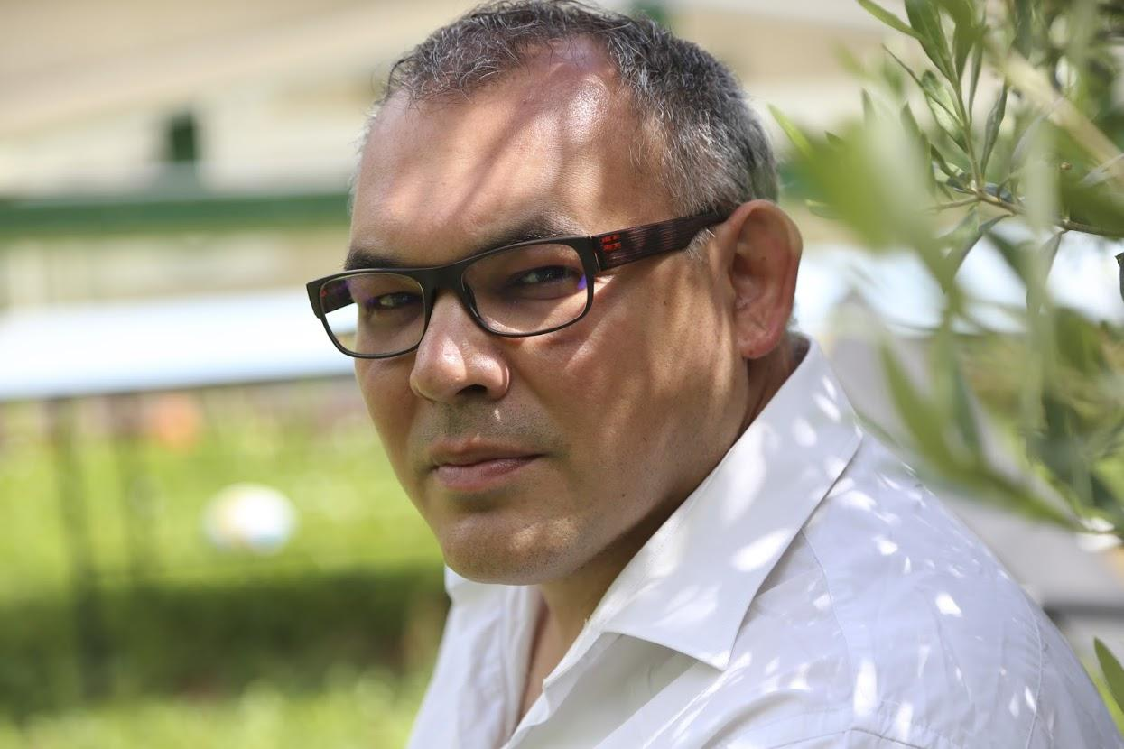
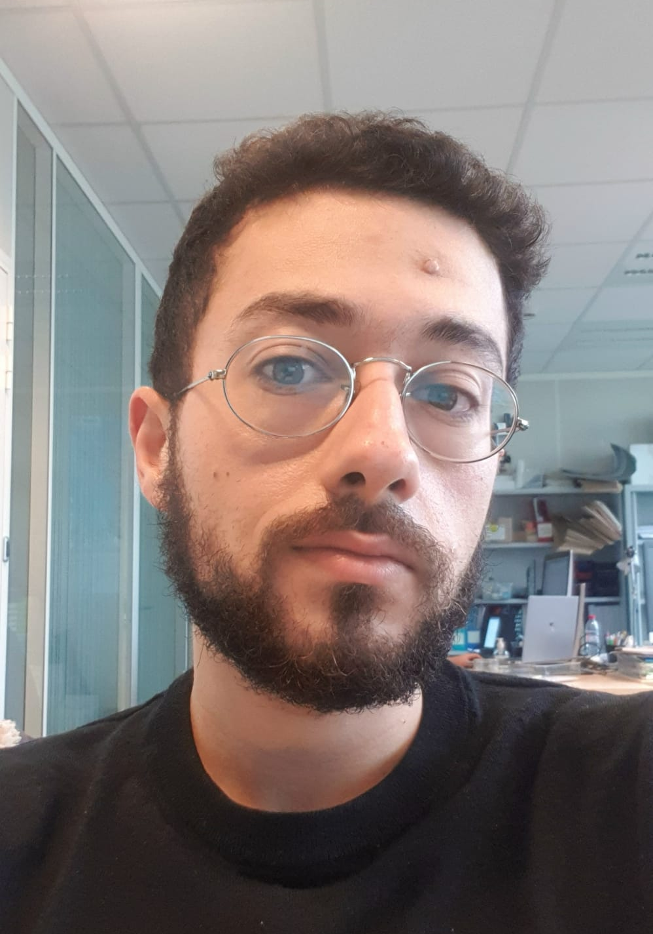

Group members
Morgane Berrod
Serdar Cekinmez
https://www.linkedin.com/in/morgane-berrod-864091142/
https://www.linkedin.com/in/serdarcekinmez/
Nizar Sayad
Lionel Shaghlil
https://www.linkedin.com/in/nizar-sayad-26b18411a/
https://www.linkedin.com/in/lionel-firas-shaghlil-5aa58014/
Notes:
Morgane

Slide 3

Project context
Writers, game conceptors, anybody who wants to create a story…
A web application which allows users to generate a story (as an example based on horror genre) with interactivity
Add interactive choices in games, series or simply help people with a lack of inspiration
Notes:
Morgane
Importance croissance technologie IA textuelle en ce moment

Slide 4



Solution Architecture
Story writing Model
Writing
User interface
Previous Input
Evaluator
Model
User Input
Notes:
Lionel

Slide 5
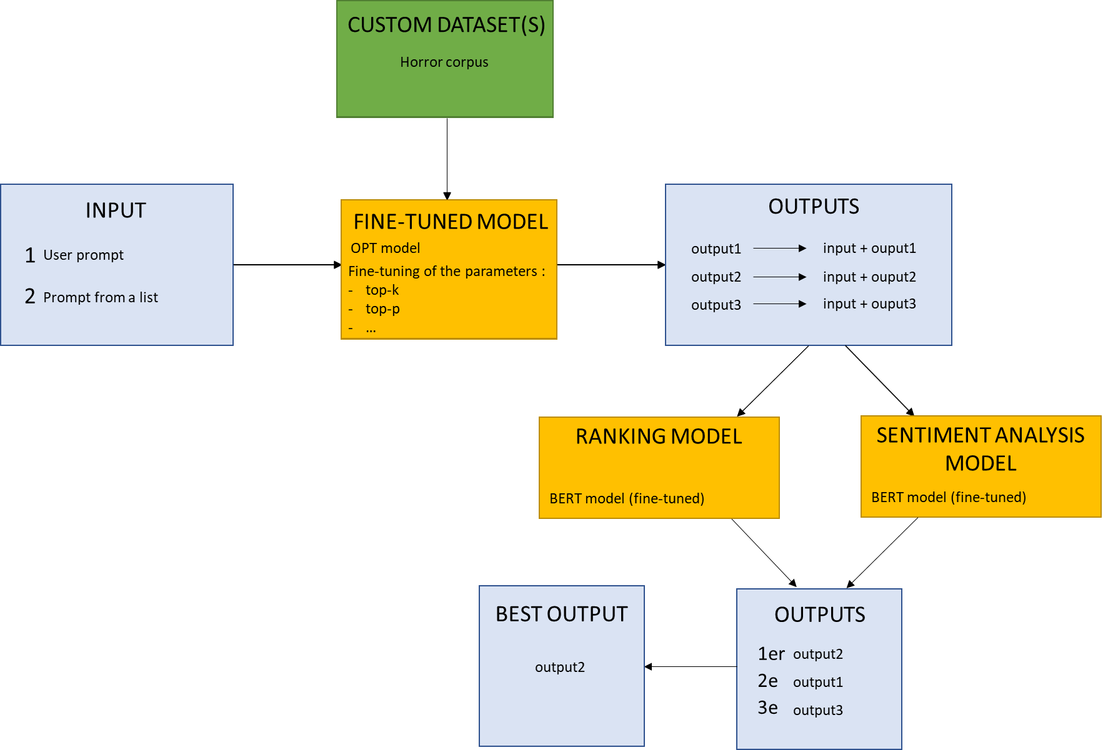
Model Architecture
Notes:
Serdar

Slide 6





Solution Architecture
AWS Server
Docker Compose
Backend
Ranker API
Frontend
Generator API
Streamlit Web application
Sentiment API
Model trained and built on HuggingFace & PyTorch Frameworks
Notes:
Morgane & Nizar

Slide 7
STORY WRITING MODEL

Slide 8

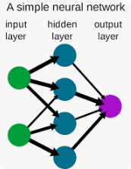
Story Writing Model
Model for “Text Generating”
NLP “Natural Language Processing”
Transformers : Encoders, Decoders, both
Existing models : Bert, OPT, F5, (GPT-2)
+
“Memory length”
Notes:
Lionel & Serdar

Slide 9
Fine Tuning
Story Writing Model
Take a pre-trained model and make it learn using another dataset
Inject dataset : a group of “horror stories” theme to train the model
model that is capable of producing a horrifying text
Fine-tuning
Pretrained-Model
OPT-350M
“Neural Network”
Models already trained based on texts scrapped from the internet
Notes:
Lionel

Slide 10



Text generator model
Fine-tuning on horror stories
Output 1
Output 2
Output 3
Story Writing Model
Notes:
Lionel

Slide 11
EVALUATOR MODEL

Slide 12



Ranking model
Sentiment analysis model
combination
Evaluator model
Best output prediction
Notes:
Nizar

Slide 13
DEMONSTRATION

Slide 14

Demonstration
Notes:
Morgane

Slide 15





What’s next ?
Predictions not cut in the middle of a sentence
Add image generator to illustrate the story
Improve inference time by optimizing by adopting frameworks optimized for LLM
Allow users to save their story
Optimize models choices and have one model per genre (thriller, comedy…)
Notes:
Morgane & Nizar & Serdar

Slide 16

Thank you for your attention !
Do you have any question ?

